Slide 1




MBC 638: Data Analysis & Decision Making
Anna Chernobai
Lecture 04:
Association among variables, correlation (Chapter 3)

Slide 2
Today:
So far we have primarily looked at descriptive statistics of one variable at a time
(exceptions: pivot tables; stacked histograms; stacked boxplots).
We are now interested in relationship or association between two (or more) variables.

Slide 3
Today:
Association among variables: categorical
Stacked bar & pie charts
Cross-tabulations
Pivot tables/charts (categorical + numerical variables)
Association among variables: numerical
Scatterplots
Covariance and Correlation
Linear regression

Slide 4
Today:
Association among variables: categorical
Stacked bar & pie charts
Cross-tabulations
Pivot tables/charts (categorical + numerical variables)
Association among variables: numerical
Scatterplots
Covariance and Correlation
Linear regression

Slide 5
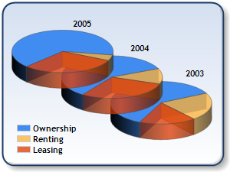
1. Association among categorical variables
Graphical techniques to display association:
Stacked/side-by-side bar or pie charts.
Numerical techniques to display association:
Crosstabulations (contingency tables or pivot tables).
 | Variable A categories
Variable B categories | count | count | count
 | count | count | count
 | count | count | count

Slide 6
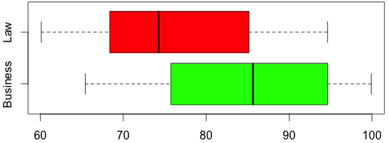
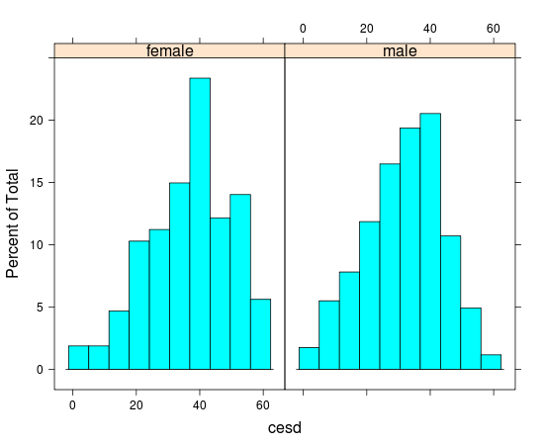
1. Association among categorical + quantitative variables
Stacked box plots:
Stacked histograms:

Slide 7

Today:
Association among variables: categorical
Stacked bar & pie charts
Cross-tabulations
Pivot tables/charts (categorical + numerical variables)
Association among variables: numerical
Scatterplots
Covariance and Correlation
Linear regression

Slide 8

2. Association among numerical variables
Example
Advertising and Sales
Advertising ($100) | Sales ($1,000)
18 | 55
7 | 17
14 | 36
31 | 85
21 | 62
5 | 18
11 | 33
16 | 41
26 | 63
29 | 87
This table contains weekly sales (in $’000) and advertising expenditures (in $’00) for 10 branches of a retail store.
We want to understand how advertising expenditures affect sales.
X = predictor = explanatory variable = independent variable
Y = response variable = dependent variable
X Y

Slide 9
2. Association among numerical variables
Graphical techniques to display association:
Scatterplot
Numerical techniques to estimate association:
Covariance (only linear association)
Correlation (only linear association)
Regression analysis (linear or nonlinear)

Slide 10
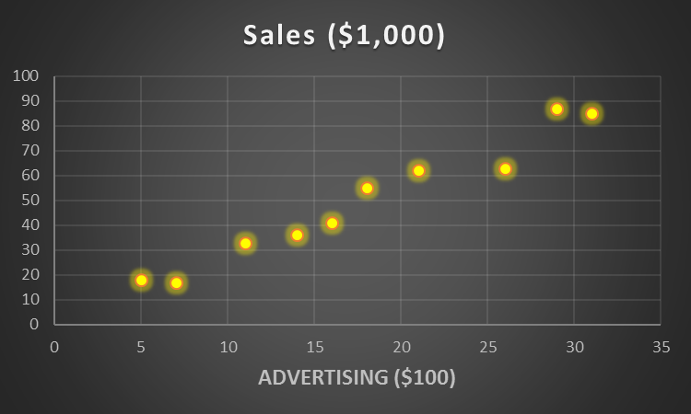
2. Association among numerical variables
Graphical technique to display association: Scatterplot
Advertising ($100) | Sales ($1,000)
18 | 55
7 | 17
14 | 36
31 | 85
21 | 62
5 | 18
11 | 33
16 | 41
26 | 63
29 | 87
Advertising and Sales
X Y

Slide 11
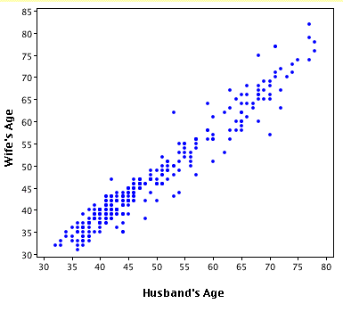
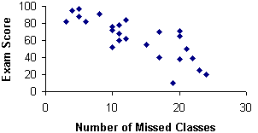
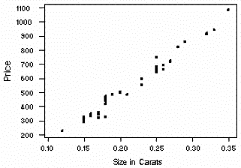
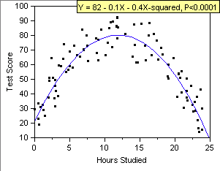
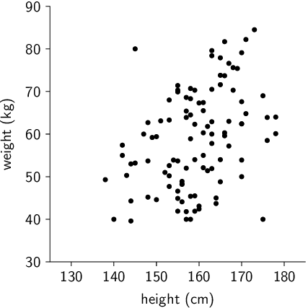
2. Association among numerical variables
Relationship between X and Y
◆ Positive Negative
❖ Linear Non-linear
⬥ Strong Weak
X

Slide 12
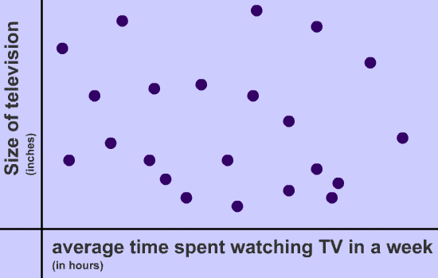
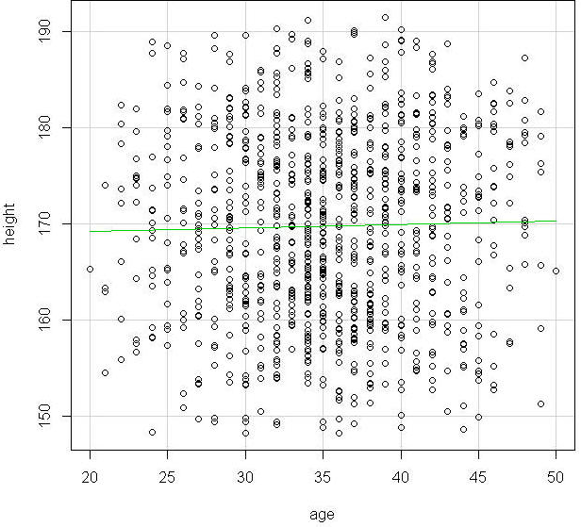
2. Association among numerical variables
Examples of no relationship:

Slide 13
2. Association among numerical variables
Numerical techniques to estimate linear association: Covariance
Note: Unlike variance that is only positive, covariance can be positive or negative.

Slide 14
2. Association among numerical variables
Advertising ($100) | Sales ($1,000)
18 | 55
7 | 17
14 | 36
31 | 85
21 | 62
5 | 18
11 | 33
16 | 41
26 | 63
29 | 87
Covariance = 219.27
Question 1: Is the relationship positive or negative?
Question 2: Is the relationship strong or weak?
X Y

Slide 15
2. Association among numerical variables
What if a relationship is nonlinear?

Slide 16
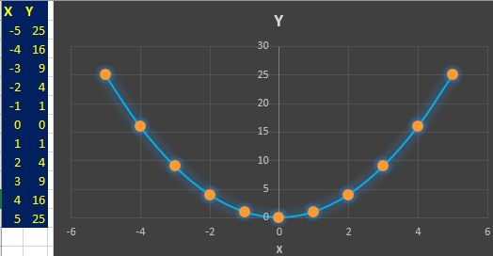
2. Association among numerical variables
What if a relationship is nonlinear?
Y=X²
Covariance = ???

Slide 17
2. Association among numerical variables
What if a relationship is nonlinear?
Y=X²
Covariance = 0
Drawback of covariance # 1: It is used only for linear relationships (always assumed so).

Slide 18
2. Association among numerical variables
Drawback of covariance #1:
It is used only for linear relationships (always assumed so).

Slide 19
2. Association among numerical variables
Advertising ($100) | Sales ($1,000)
18 | 55
7 | 17
14 | 36
31 | 85
21 | 62
5 | 18
11 | 33
16 | 41
26 | 63
29 | 87
Covariance = 219.27
Question 1: Is the relationship positive or negative?
Question 2: Is the relationship strong or weak?
X Y

Slide 20
2. Association among numerical variables
Drawback of covariance #1:
It is used only for linear relationships (always assumed so).
Drawback of covariance #2:
Covariance does not tell us about the strength of the association.

Slide 21
2. Association among numerical variables
Numerical techniques to estimate linear association: Correlation Coefficient
r can be positive or negative
Is a standardized measure of correlation: -1 ≤ r ≤ +1
The closer to +1 or -1, the stronger the relationship.
Hence, r shows not only the sign or relationship but also the strength

Slide 22
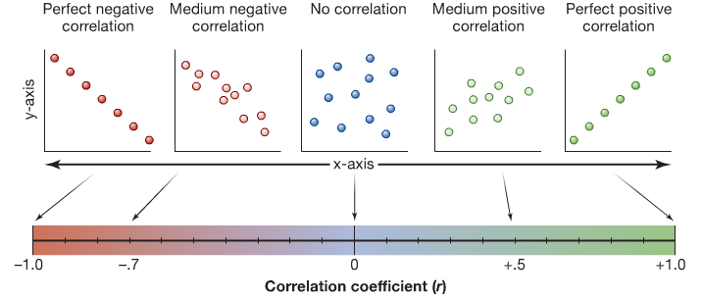
2. Association among numerical variables
Correlation Coefficient

Slide 23
2. Association among numerical variables
Advertising ($100) | Sales ($1,000)
18 | 55
7 | 17
14 | 36
31 | 85
21 | 62
5 | 18
11 | 33
16 | 41
26 | 63
29 | 87
Covariance = 219.27 (positive)
Correlation = 0.98 (positive and strong)
X Y

Slide 24
2. Association among numerical variables
Advertising ($100) | Sales ($1,000)
18 | 55
7 | 17
14 | 36
31 | 85
21 | 62
5 | 18
11 | 33
16 | 41
26 | 63
29 | 87
Covariance = 219.27 (positive)
Correlation = 0.98 (positive and strong)
Question 1: Is the relationship positive or negative?
Question 2: Is the relationship strong or weak?
Question 3: Does correlation imply causation?
X Y

Slide 25
2. Association among numerical variables
In this example (advertising and sales), we assume that the amount of money spent on advertising affects sales. It’s common sense!

Slide 26
2. Association among numerical variables
Let’s look at a few examples with real data to understand causation…

Slide 27
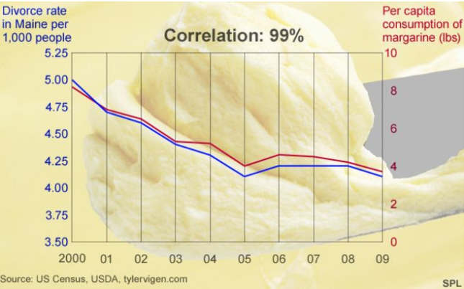


Correlation and causation
X
Y

Slide 28
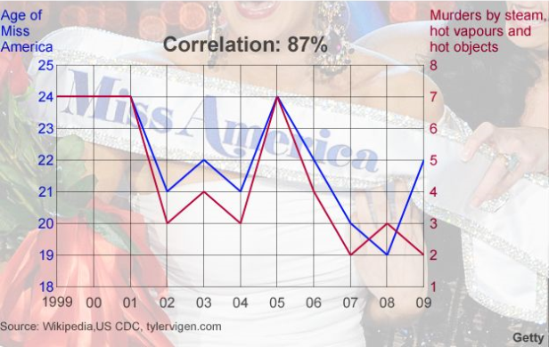


Correlation and causation

Slide 29

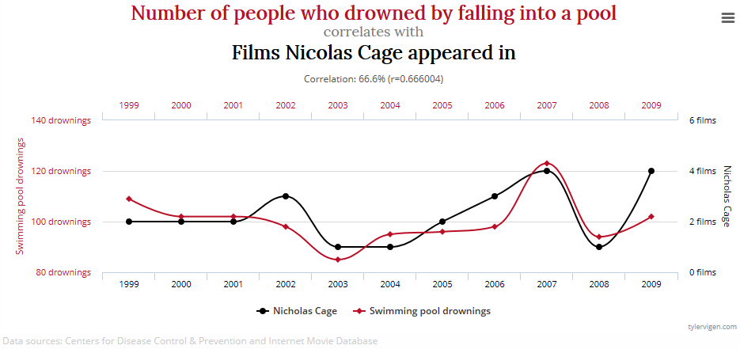
Correlation and causation

Slide 30


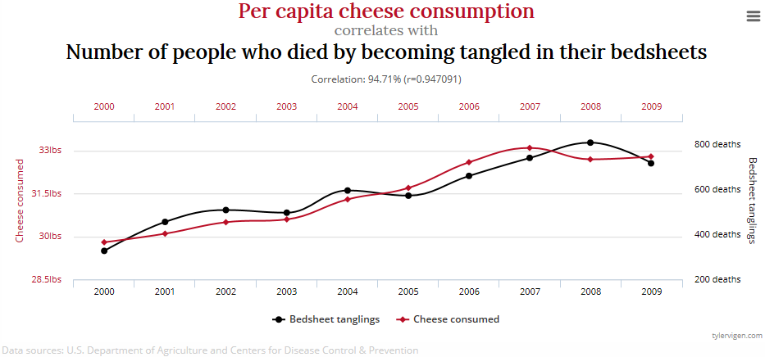
Correlation and causation

Slide 31


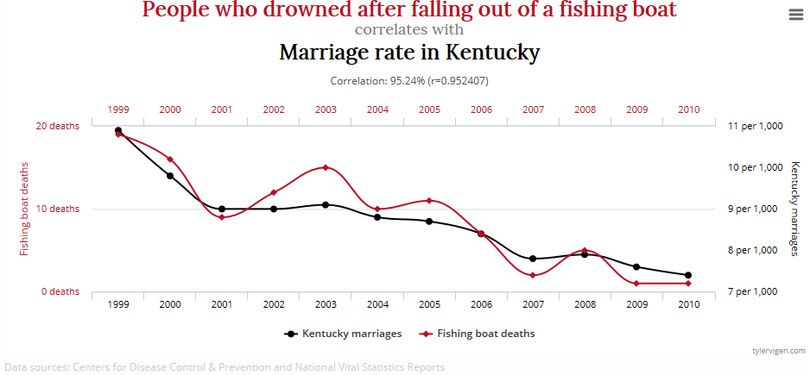
Correlation and causation

Slide 32


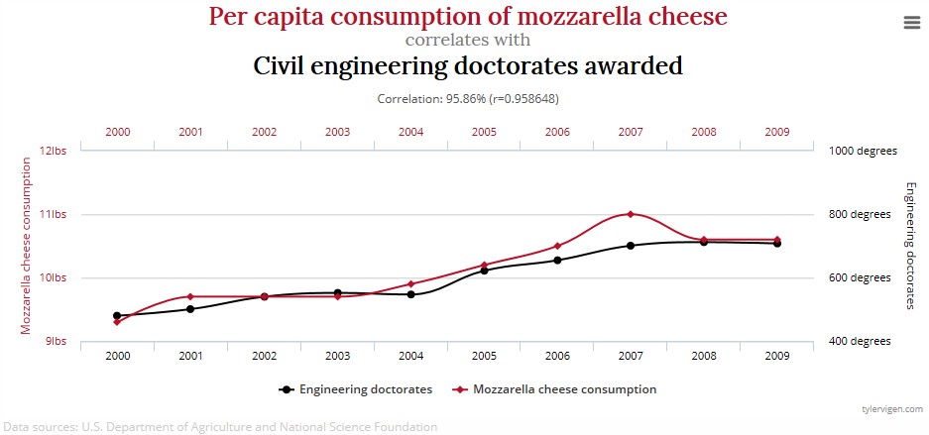
Correlation and causation

Slide 33

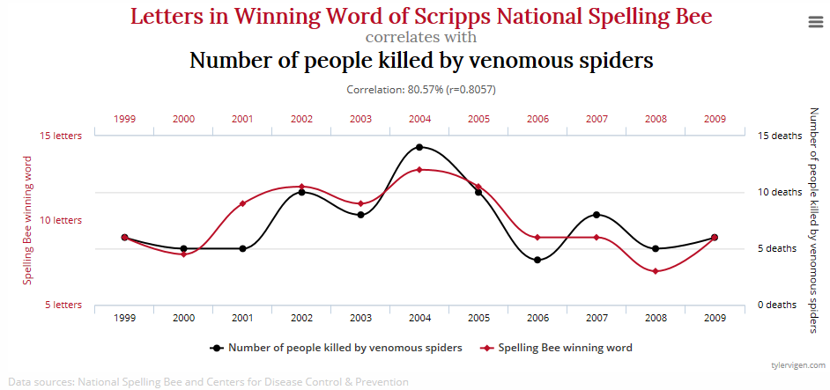

Correlation and causation

Slide 34
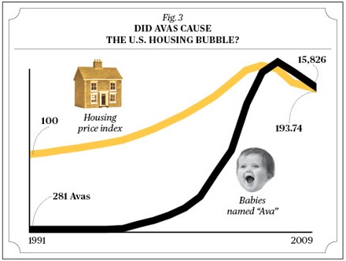


Correlation and causation

Slide 35
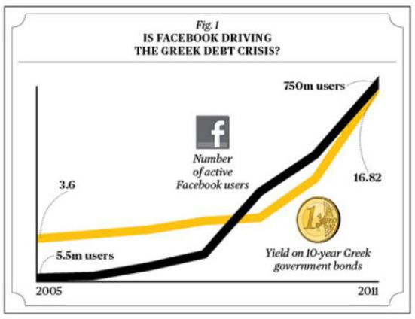

Correlation and causation

Slide 36



Correlation and causation
A student notices that on the days she is too lazy to wake up and get ready for college, are the days when there are road accidents.
Of course, there is no correlation! The reason here is probably the bad weather, which causes her to become sleepy, and also causes road accidents.

Slide 37


Correlation and causation
There appears to be a connection between the price of alcohol and the high salaries of government officials.
Of course, there is no relationship here! The fact is, politicians and political parties generally reside in urban areas, and salaries and costs tend to be higher in the cities.

Slide 38


Correlation and causation
Another trend observed has been the correlation between ice-cream sales and the number of deaths by drowning.
The lurking factor here may be the weather ― people tend to have more ice cream during the summer months, and also prefer to go for a swim accounting to the warm weather, which may lead to drowning if proper care is not taken.

Slide 39
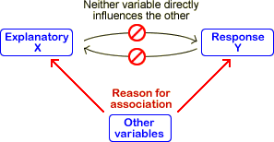
2. Association among numerical variables
Drawback of covariance & correlation #1:
It is used only for linear relationships (always assumed so).
Drawback of covariance (but not correlation) #2:
Covariance does not tell us about the strength of the association.
Drawback of covariance & correlation #3:
They don’t imply causation (what affects what).
In causal relations, a change in one variable causes a change in the other variable.
In spurious relations, two variables are wrongly assumed to be related to each other.
In spurious relations, there is typically a 3rd lurking variable that drives both variables.

Slide 40
2. Association among numerical variables
Drawback of covariance & correlation #1:
It is used only for linear relationships (always assumed so).
Drawback of covariance (but not correlation) #2:
Covariance does not tell us about the strength of the association.
Drawback of covariance & correlation #3:
They don’t imply causation.
Drawback of covariance & correlation #4:
Covariance & correlation are descriptive in nature. Correlation is a very informal/preliminary/descriptive way to examine relationship between 2 variables.
We also say that correlation is a univariate method to study association.
Multivariate methods include multiple regression models (next topic).

Slide 41
Today:
Association among variables: categorical
Stacked bar & pie charts
Cross-tabulations
Pivot tables/charts (categorical + numerical variables)
Association among variables: numerical
Scatterplots
Covariance and Correlation
Linear regression

Slide 42
3. Simple linear regression
Regression analysis is one of the most useful tools for a business analyst.
Examples of applications in business:
How do wages of employees depend on years of experience, years of education, and gender?
How does the current price of a stock depend on its own past values, as well as the current and past values of a market index?
How does the selling price of a house depend on such factors as the appraised value, square footage, number of bedrooms in the house, number of baths, and geographical location?
How does the probability of bankruptcy depend on a firm’s profitability, distance-to-default, firm size, executive compensation’s stock price sensitivity, and governance such as the proportion of independent directors on the board?

Slide 43
3. Simple linear regression
Two main objectives of regression analysis:
To understand how the world operates, i.e., understanding the association
To make predictions ( in-sample and out-of-sample), i.e., “what-if” analysis
For example, we can not only understand how a company’s sales are affected by its advertising expenditures, but we can also use the company’s records of current and past advertising levels to predict future sales.

Slide 44
3. Simple linear regression
Classifications of regression methods
By number of predictors:
Simple regression: only one explanatory variable
Multiple regression: two or more explanatory variables
Linear and nonlinear regressions:
Linear regression: relationship between variables can be explained by a straight line.*
Nonlinear regression: relationship is curved. However, many nonlinear relationships can be linearized. E.g., y=exp(x) can be transformed into a linear relationship by taking log of the dependent variable y, ln(y)=x.
Other examples of regressions include models where the dependent variable is not bell-shaped and/or is discrete (e.g., Logistic, Poisson, probit regressions).
*The book covers only linear relationships. We will cover linear, nonlinear, and Logistic in this class.

Slide 45
3. Simple linear regression
Idea: Find the straight line that best fits the scatterplot.
For the example on weekly advertising expenditures and sales:
x ($100) | 18 7 14 31 21 5 11 16 26 29
y ($1,000) | 55 17 36 85 62 18 33 41 63 87

